Slide 1
Subject: SOFTWARE ENGINEERING Subject Code: 3CS4-07 UNIT I: Introduction to Software Engineering
GLOBAL INSTITUTE OF TECHNOLGY JAIPUR
Software Engineering
III SEM CS

Slide 2
Recommended books:
TextBook1 :- “Software Engineering” Roger S. Pressman, TMH, sixth edition.
TextBook2 :- “Software Engineering Fundamentals” Ali Behforooz and Frederick J. Hudson,(2nd ed.”)
TextBook3 :- “Software requirements” Karl E. Wiegers

Slide 3
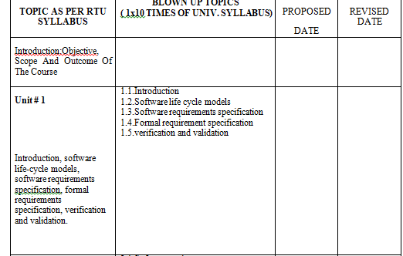

Slide 4
What is software engineering?
“Software engineering is the practical application of scientific knowledge in the design and the construction of programs and associated documentation required to develop, operate and maintain them”.
According to Boehm- Software being a commercial products, calls for engineering approach to ensure that it is design with correct choice of technology.

Slide 5
Introduction to Software Engineering
Software Processes
IEEE defined a software process as: “a set of activities, practices and transformations that people use to develop and maintain software and the associated products, e.g., project plans, design documents, code, test cases and user manual”.

Slide 6
What is Software?
Software is combination of:
(1) instructions (computer programs) that when executed provide desired features, function, and performance;
(2) data structures that enable the programs to adequately manipulate information and
(3) documentation that describes the operation and use of the programs.

Slide 7
Characteristics of software
There are various characteristic of software including:
Understandability- To what extent is the process explicitly defined and how easy is to understand the process.
Visibility- Do the process activities culminate in clear result so that the progress of process is visible.
Robustness- Can the process continues in spite of unexpected problems.
Acceptability- Is the defined process acceptable to and usable by engineers responsible for producing software product.
Supportability- To what extent CASE tool support the process activities.

Slide 8
What is Engineering?
Engineering, is all about developing products, using well-defined, scientific principles and methods.
So, we can define software engineering as an engineering branch associated with the development of software product using well-defined scientific principles, methods and procedures.
The outcome of software engineering is an efficient and reliable software product.

Slide 9

LAYERS OF SOFTWARE ENGINEERING

Slide 10
Software Activities in A Process Model
A generic process framework for software engineering encompasses five activities:
Communication
Planning
Modeling
Construction
Deployment

Slide 11
Various Process Models
A number of software processes are available. However, no single software process works well for every project. Each process works best in certain environments.
Examples of the available software process models include:
Waterfall model (the Linear model)
Evolutionary development
Formal systems development
Reuse-based (component-based) development
Incremental model
Spiral model
Extreme Programming

Slide 12
Sdlc (software life-cycle models)
SDLC stand for “SOFTWARE DEVELOPMENT LIFE CYCLE”.
It represents number of identifiable stages under which software goes during its life.
It is a diagrammatically representation which also provide description of various phases and their sequence in life cycle of software product.
Software undergoes basic stages during its life cycle i.e. requirement analysis and specification, design, coding and maintenance.
We have different SDLC models, each one have its own advantage and disadvantage
on the basis of:
Development speed
Product Quality
Project Visibility
Risk Exposure
Administrative overhead

Slide 13
Types of sdlc
There are many software development life-cycle models as there is no general agreement about various phases and their sequence in product life cycle. Some most commonly used life cycles models are given :
i. Waterfall model
ii. Prototype model
iii. Spiral model
iv. Evolutionary development model
v. Iterative enhancement model

Slide 14
Sdlc: waterfall models
It is a theoretical software development model.
It is developed by BOEHM in 1970.
It is also known as classical,traditional, conventional or linear segment model.
There are different stages to the development and the output of first stage flow to the next stage and so on.
It force on sequential phase
development in which no phase can overlap another phase.
Each phase of this model is well define the starting and ending criteria which is to be documented by which the standard outputs produce by each phase can formulate.

Slide 15
Phases of Waterfall modelS
Phases of Waterfall model: All work flows from communication towards deployment in a reasonably linear fashion.
Communication: includes project initiation and requirements gathering activities.
Planning: includes estimating, scheduling and tracking activities.
Modeling: includes analysis and design activities.
Construction: includes coding and testing activities.
Deployment: includes product delivery, support and feedback activities.

Slide 16
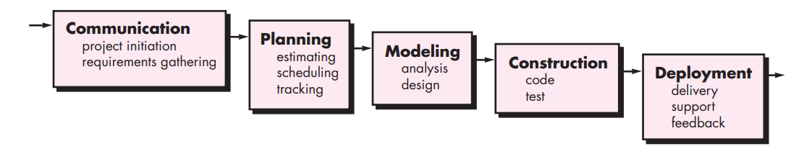
Generic Waterfall Model

Slide 17
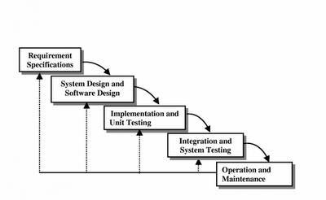
Iterative Waterfall Model

Slide 18
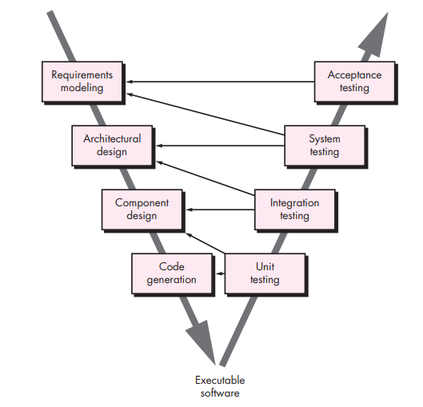
THE V-MODEL
A variation in the representation of the waterfall model is called the V-model. Represented in Figure, the V-model depicts the relationship of quality assurance actions to the actions associated with communication, modeling, and early construction activities.

Slide 19
Thank You!

